Slide 1
IP Static Routing
Notes:
Cisco Networking Academy Program
Switching, Routing, and Wireless Essentials v7.0 (SRWE)
Module 15: IP Static Routing

Slide 2
IP Routing Table Route Sources
A routing table contains a list of routes to known networks (prefixes and prefix lengths). The source of this information is derived from the following:
Directly connected networks
Static routes
Dynamic routing protocols
The source for each route in the routing table is identified by a code. Common codes include the following:
L - Identifies the address assigned to a router interface.
C - Identifies a directly connected network.
S - Identifies a static route created to reach a specific network.
O - Identifies a dynamically learned network from another router using the OSPF routing protocol.
* - This route is a candidate for a default route.
Notes:
14 - Routing Concepts
14.4 - IP Routing Table
14.4.1 - Route Sources

Slide 3
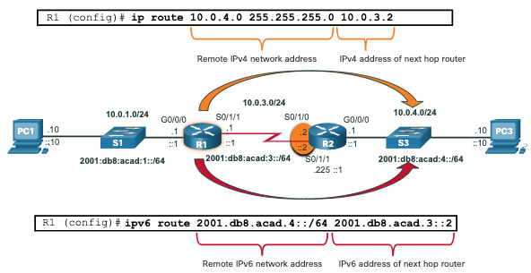
IP Routing Table Static Routes in the IP Routing Table
The topology in the figure is simplified to show only one LAN attached to each router. The figure shows IPv4 and IPv6 static routes configured on R1 to reach the 10.0.4.0/24 and 2001:db8:acad:4::/64 networks on R2.
Notes:
14 - Routing Concepts
14.4 - IP Routing Table
14.4.6 - Static Routes in the IP Routing Table

Slide 4
Static Routes IPv4 Static Route Command
IPv4 static routes are configured using the following global configuration command:
Router(config)# ip route network-address subnet-mask { ip-address | exit-intf [ip-address]} [distance]
Note: Either the ip-address, exit-intf, or the ip-address and exit-intf parameters must be configured.
Notes:
15 – IP Static Routing
15.1 – Static Routes
15.1.3 - IPv4 Static Route Command

Slide 5
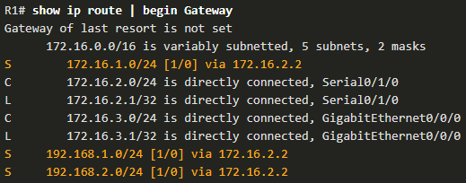
Configure IP Static Routes IPv4 Next-Hop Static Route
In a next-hop static route, only the next-hop IP address is specified. The exit interface is derived from the next hop. For example, three next-hop IPv4 static routes are configured on R1 using the IP address of the next hop, R2.
R1(config)# ip route 172.16.1.0 255.255.255.0 172.16.2.2
R1(config)# ip route 192.168.1.0 255.255.255.0 172.16.2.2
R1(config)# ip route 192.168.2.0 255.255.255.0 172.16.2.2
The resulting routing table entries on R1:
Notes:
15 – Static IP Routes
15.2 – Configure IP Static Routes
15.2.1 - IPv4 Next-Hop Static Route

